Slide 1


CROP MODELING OF LOW-INPUT SMALLHOLDER SYSTEMS
Gatien Falconnier & Marc Corbeels et al.

Slide 2

CROP MODELING OF LOW-INPUT SMALLHOLDER SYSTEMS
Goal of this AgMIP activity:
to improve the predictive capacity of crop models under climate change in low soil fertility/low input cropping systems of the (sub)tropics
Specific objectives :
to compare a number of crop growth models for simulating crop (maize) growth under low soil fertility
to assess the impact of climate change on crop productivity and quantify uncertainty (and its factors)
to identify the gaps in simulating crop growth responses to climate change under low soil fertility/low input cropping systems

Slide 3

Rationale
In many systems, especially in sub-Saharan Africa, soil fertility is low due to inadequate use of fertilizer inputs and ongoing soil degradation.
This affects the crop responses to climate change.
Low soil fertility systems with minimal fertilizers may be less sensitive to weather and CO₂ changes, given other crop growth limiting factors (nutrients and water).
At the same time, low-input farmers have lower ability to cope with climate change, compared to well-capitalized, high-input farms.
Uncertainty in predicting crop yields under climate change by current crop models is probably highest for low-input cropping systems of sub-Saharan Africa.

Slide 4
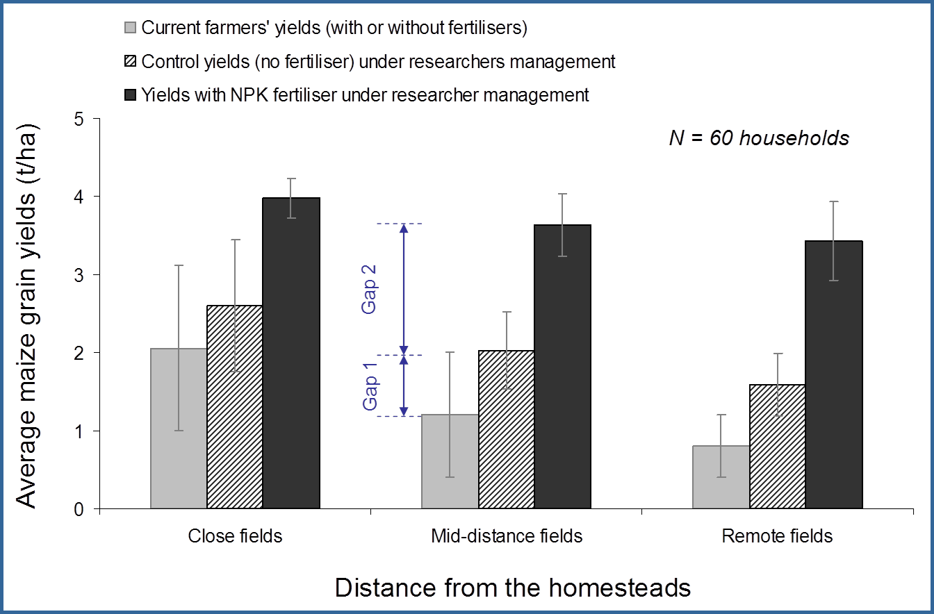
Yield gaps: medium–to-infertile soils in Western kenya
Notes:
If we look at yield data in such type of conditions – we see that fields close to the homestead aere in general higher and respond better to inputs of fertilizer, but also to other mangement practices such as weeding or pest control

Slide 5
Approach
Identification of 4 pilot sites with existing data and construction of databases according to the AgMIP format/standard
Intercomparison of crop models (as many as possible) for maize growth
Assessment of impact of climate change on maize yields in low soil fertility/low input cropping systems

